Slide 1
Introduction to Computer Graphics with WebGL
Ed Angel
Professor Emeritus of Computer Science
Founding Director, Arts, Research, Technology and Science Laboratory
University of New Mexico
Angel and Shreiner: Interactive Computer Graphics 7E © Addison-Wesley 2015

Slide 2
WebGL Texture Mapping I
Ed Angel
Professor Emeritus of Computer Science
University of New Mexico
Angel and Shreiner: Interactive Computer Graphics 7E © Addison-Wesley 2015

Slide 3
Objectives
Introduce WebGL texture mapping
  two-dimensional texture maps
  assigning texture coordinates
  forming texture images
Angel and Shreiner: Interactive Computer Graphics 7E © Addison-Wesley 2015

Slide 4
Basic Stragegy
Three steps to applying a texture
  specify the texture
    read or generate image
    assign to texture
    enable texturing
  assign texture coordinates to vertices
    Proper mapping function is left to application
  specify texture parameters
    wrapping, filtering
Angel and Shreiner: Interactive Computer Graphics 7E © Addison-Wesley 2015

Slide 5
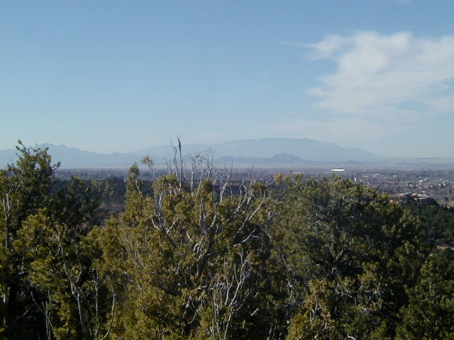
Texture Mapping
y
z
x
geometry
display
t
image
s
Angel and Shreiner: Interactive Computer Graphics 7E © Addison-Wesley 2015

Slide 6
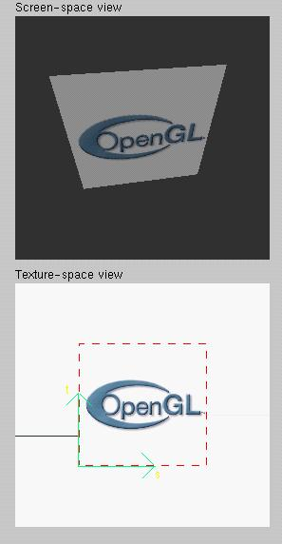
Texture Example
The texture (below) is a 256 x 256 image that has been mapped to a rectangular polygon which is viewed in perspective
Angel and Shreiner: Interactive Computer Graphics 7E © Addison-Wesley 2015

Slide 7
Texture Mapping and the WebGL Pipeline
Images and geometry flow through separate pipelines that join during fragment processing
  “complex” textures do not affect geometric complexity
vertices
geometry pipeline
fragmentprocessor
image
texel pipeline
Angel and Shreiner: Interactive Computer Graphics 7E © Addison-Wesley 2015

Slide 8
Specifying a Texture Image
Define a texture image from an array of
texels (texture elements) in CPU memory
Use an image in a standard format such as JPEG
  Scanned image
  Generate by application code
WebGL supports only 2 dimensional texture maps
  no need to enable as in desktop OpenGL
  desktop OpenGL supports 1-4 dimensional texture maps
Angel and Shreiner: Interactive Computer Graphics 7E © Addison-Wesley 2015

Slide 9
Define Image as a Texture
glTexImage2D( target, level, components,
w, h, border, format, type, texels );
target: type of texture, e.g. GL_TEXTURE_2D
level: used for mipmapping (discussed later)
components: elements per texel
w, h: width and height of texels in pixels
border: used for smoothing (discussed later)
format and type: describe texels
texels: pointer to texel array
glTexImage2D(GL_TEXTURE_2D, 0, 3, 512, 512, 0, GL_RGB, GL_UNSIGNED_BYTE, my_texels);
Angel and Shreiner: Interactive Computer Graphics 7E © Addison-Wesley 2015

Slide 10
A Checkerboard Image
var image1 = new Uint8Array(4*texSize*texSize);
for ( var i = 0; i < texSize; i++ ) {
for ( var j = 0; j <texSize; j++ ) {
var patchx = Math.floor(i/(texSize/numChecks));
var patchy = Math.floor(j/(texSize/numChecks));
if(patchx%2 ^ patchy%2) c = 255;
else c = 0;
//c = 255*(((i & 0x8) == 0) ^ ((j & 0x8) == 0))
image1[4*i*texSize+4*j] = c;
image1[4*i*texSize+4*j+1] = c;
image1[4*i*texSize+4*j+2] = c;
image1[4*i*texSize+4*j+3] = 255;
}
}
Angel and Shreiner: Interactive Computer Graphics 7E © Addison-Wesley 2015

Slide 11
Using a GIF image
// specify image in JS file
var image = new Image();
image.onload = function() {
configureTexture( image );
}
image.src = "SA2011_black.gif”
// or specify image in HTML file with <img> tag
// <img id = "texImage" src = "SA2011_black.gif"></img>
var image = document.getElementById("texImage”) window.onload = configureTexture( image );
Angel and Shreiner: Interactive Computer Graphics 7E © Addison-Wesley 2015

Slide 12
Mapping a Texture
Based on parametric texture coordinates
Specify as a 2D vertex attribute
Texture Space
Object Space
t
1, 1
(s, t) = (0.2, 0.8)
0, 1
A
a
c
(0.4, 0.2)
b
B
C
0, 0
1, 0
s
(0.8, 0.4)
Angel and Shreiner: Interactive Computer Graphics 7E © Addison-Wesley 2015

Slide 13
Cube Example
var texCoord = [
vec2(0, 0),
vec2(0, 1),
vec2(1, 1),
vec2(1, 0)
];
function quad(a, b, c, d) {
pointsArray.push(vertices[a]);
colorsArray.push(vertexColors[a]);
texCoordsArray.push(texCoord[0]);
pointsArray.push(vertices[b]);
colorsArray.push(vertexColors[a]);
texCoordsArray.push(texCoord[1]);
// etc
Angel and Shreiner: Interactive Computer Graphics 7E © Addison-Wesley 2015

Slide 14
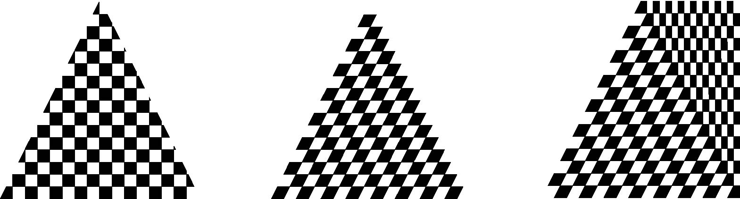
Interpolation
WebGL uses interpolation to find proper texels from specified texture coordinates
Can be distortions
texture stretched
over trapezoid
showing effects of
bilinear interpolation
good selection
of tex coordinates
poor selection
of tex coordinates
Angel and Shreiner: Interactive Computer Graphics 7E © Addison-Wesley 2015

